Slide 1
Does perceived labor market competition increase prejudice between refugees and their local hosts? Evidence from Uganda and Ethiopia
Julie Bousquet, Anna Gasten, Mark Marvin Kadigo, Jean-François Maystadt, & Colette Salemi
JDC Third Research Conference on Forced Displacement
Abidjan, Côte d’Ivoire
September 20th, 2023

Slide 2
INTRODUCTION

Slide 3
Integration is the only viable durable solution for many refugees
Integrating refugees into markets and society to reduce aid dependence and promote welfare
Integration efforts often focused on shared services
Negative attitudes about refugees persist
Often expressed through claims of refugees “stealing jobs”
Notes:
The probability of resettlement is less than 1 percent annually. Resettlement can take decades of paperwork and vetting.
Voluntary return is another long-term solution to displacement. But we know that many refugee populations are not going home anytime soon.
The only durable solution available for true human development for refugees is integration – refugees becoming regular participants in markets and society.
Governments often try to promote integration through policies. For example, governments may require that services at camps are shared with the local community, in the hopes that this brings communities closer. Or governments offer refugees considerable opportunities to participate in markets and create businesses. But even in such contexts, relations between refugees and hosts may remain antagonistic.
Our paper asks whether perceptions of labor market competition may lead to more prejudice towards refugees, compromising integration efforts.

Slide 4
Our study seeks to answer the question:
Do perceptions of labor market competition influence out-group attitudes in refugee hosting contexts?

Slide 5
Survey experiment
Vignette experiment conducted in rural/urban Ethiopia and Uganda
Survey refugees and local (“host”) community
Vignette tells story about jobseeker
Randomize refugee/national
Randomize same/different occupation
Ask inclusion questions about vignette character

Slide 6
part of DISCOURSE on increasing refugee inclusion
Contact hypothesis (Betts et al. 2022; Scacco & Warren 2018)
Cash transfers (Valli, Peterman, & Hidrobo, 2019, Baseler et al. 2022, Lehmann & Masterson 2020)
Vignette experiments (Adida, Lo & Platas 2018; Cattaneo & Grieco 2021; Chatruc et al. 2021)
Focus on shared commonality (Lazarev & Sharma, 2017; Dinas, Fouka & Schlapfer 2021)

Slide 7
Study also sheds light on anti-migrant prejudice
What fuels anti-migrant prejudice?
Private economic concerns (labor, tax burdens)
Sociotropic factors (“identity of the nation”)
Common finding: sociotropic factors matter, private concerns don’t (Hainmueller & Hiscox, 2010)
Exception: Mayda (2006)

Slide 8
CONTEXT

Slide 9
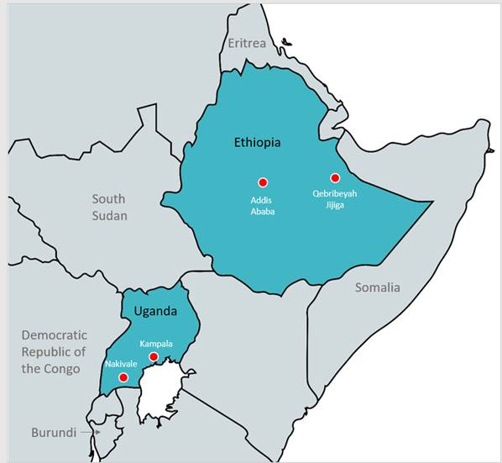

Slide 10
Refugee hosting policies
Uganda (1.3m refugees) : large emphasis on self-reliance
Large refugee settlements (Nakivale: 185 sq km)
Agricultural land allocations
Right to work & own a business, free mobility
Ethiopia (0.8m refugees) : moving away from illiberal policies
Refugee camps instead of settlements
2010 – Eritreans gain right to live outside of camps
2019 – All refugees have free mobility, right to work & live outside camps
Notes:
There are about 1.36 million refugees in Uganda, about 3% of the population.
There are about 800,000 refugees in Ethiopia, less than 1% of the population.

Slide 11
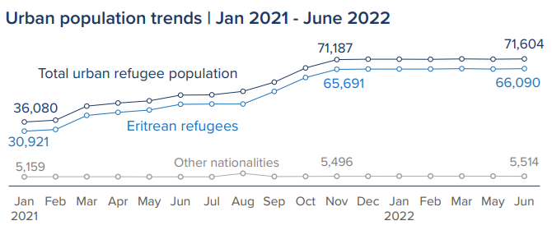
The Tigray War
Tigray War made Eritrean refugees in Tigray a target
Since Jan. 2021, refugee population in Addis Ababa has doubled
But refugees are a very small share of the Addis population (1.7%)
Notes:
But keep in mind that there are 5 million people in Addis Ababa metro area. Refugees make up about 1.4% of the population.

Slide 12
DATA

Slide 13
Data collection
January 2022 – July 2022
Two-stage sampling
Use pre-existing sampling frames (enumeration areas)
Randomly sample EA’s with refugees and hosts
Additional round of random household sampling to capture more refugees
Random selection of one adult household member for survey
Survey focuses on labor market characteristics and out-group attitudes

Slide 14
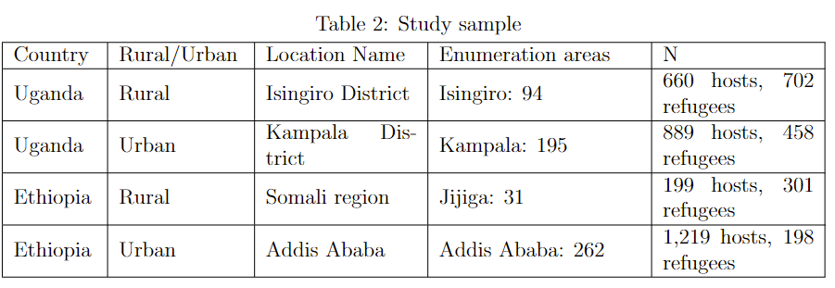

Slide 16
ATTITUDES Questions
5-point Likert scale self-reported responses
I would feel comfortable when interacting with Aida/Robert
I would get along with Aida/Robert
I am comfortable if someone like Aida/Robert lives close to me
I am comfortable if someone like Aida/Robert marries a family member
Someone like Aida/Robert can work with me
Someone like Aida/Robert can become my supervisor

Slide 17
Anderson index
Anderson (2008) approach to constructing index
Generalized least squares weighting based on relative importance of each indicator
Interpreted as SD change
Higher values represent more negative attitudes
General interpretations from Anderson
0.2 SD $∆$ change is “small” effect
0.5 SD $∆$ is “medium” effect
0.9 SD $∆$ is “large” effect

Slide 18
METHOD

Slide 19
Estimation strategy
$$y_{i}=α_{0}+α_{1}OutGroup_{i}+α_{2}SameOcc_{i}+$$
$α_{3}\left(OutGroup_{i}×SameOcc_{i}\right)+X_{i}^{′}γ+u_{i}$
$y_{i}$ is attitudes index
$OutGroup_{i}=1$ if vignette character in outgroup
$SameOcc_{i}=1$ if vignette character has same occupation
Control for demographic factors $γ$
Cluster SE at EA level

Slide 20
$α_{1}$ interpretation
$$y_{i}=α_{0}+α_{1}OutGroup_{i}+α_{2}SameOcc_{i}+$$
$α_{3}\left(OutGroup_{i}×SameOcc_{i}\right)+X_{i}^{′}γ+u_{i}$
$α_{1}:$the effect of exposure to a vignette character in the respondent's outgroup who is working in a different occupation, relative to those exposed to a vignette character who is an ingroup member working in a different occupation.

Slide 21
$α_{2}$ interpretation
$$y_{i}=α_{0}+α_{1}OutGroup_{i}+α_{2}SameOcc_{i}+$$
$α_{3}\left(OutGroup_{i}×SameOcc_{i}\right)+X_{i}^{′}γ+u_{i}$
$α_{2}:$the effect of exposure to a vignette character in the respondent's ingroup who works in the same occupation as the respondent, relative to respondents exposed to an ingroup member working in a different occupation.

Slide 22
$α_{3}$ interpretation
$$y_{i}=α_{0}+α_{1}OutGroup_{i}+α_{2}SameOcc_{i}+$$
$α_{3}\left(OutGroup_{i}×SameOcc_{i}\right)+X_{i}^{′}γ+u_{i}$
$α_{3}:$the effect of exposure to an outgroup member in the same occupation relative to all other treatments combined.

Slide 23
RESULTS

Slide 24
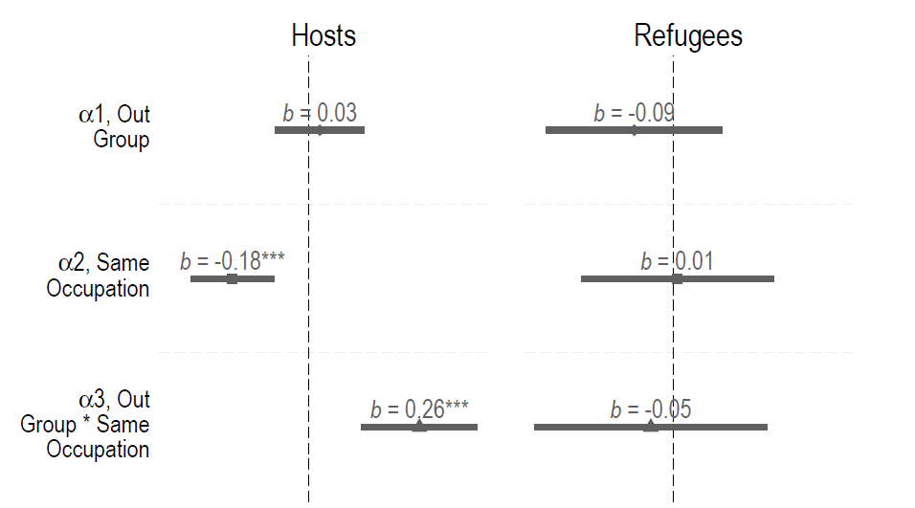

Slide 25
Main RESULTS
Host attitudes worsen by 0.26 SD when presented with a refugee character in the same occupation
“Small” effect
Hosts attitudes the same for refugee vs. host in different occupation
No significant effects for refugee respondents

Slide 26
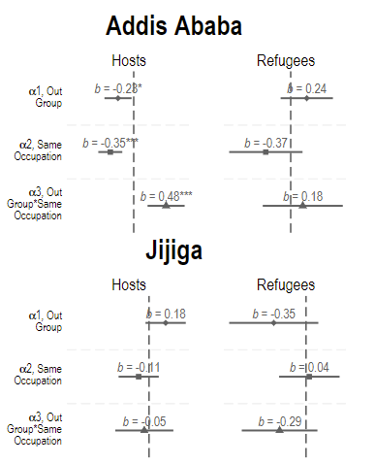
Ethiopia
Addis Ababa: Exposure to a refugee character in same occupation results in worsening of host attitudes by 0.5 SD
“Medium” effect size
Results for refugee sub-samples are underpowered

Slide 27
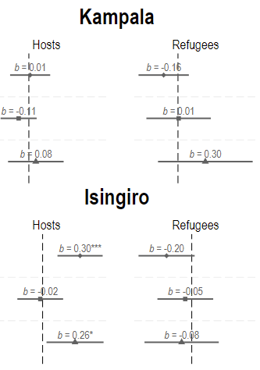
uganda
Isingiro: Exposure to a refugee character in different occupation results in worsening of host attitudes by 0.3 SD
Higher “small” effect size
Weak evidence of more negative host attitudes (0.26 SD) if refugee is in same occupation

Slide 28
Results for uganda
Labor market competition matters less relative to Ethiopia
Refugees in Isingiro are a large share of the population
More experience working alongside refugees in labor market?
Negative attitudes among hosts persist despite state investments aimed at inclusion
Effects for refugees null

Slide 29
HETEROGENEITY

Slide 30
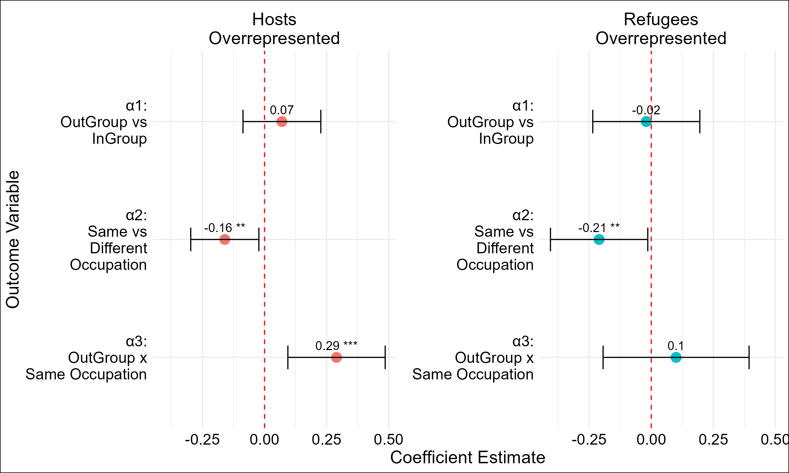
Based on industry
average, results for hosts only

Slide 31
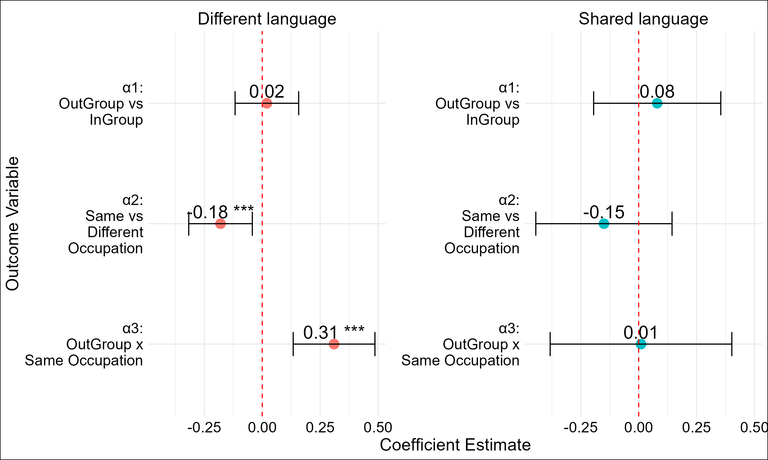
Does host speak
same language as dominant refugee group?

Slide 32
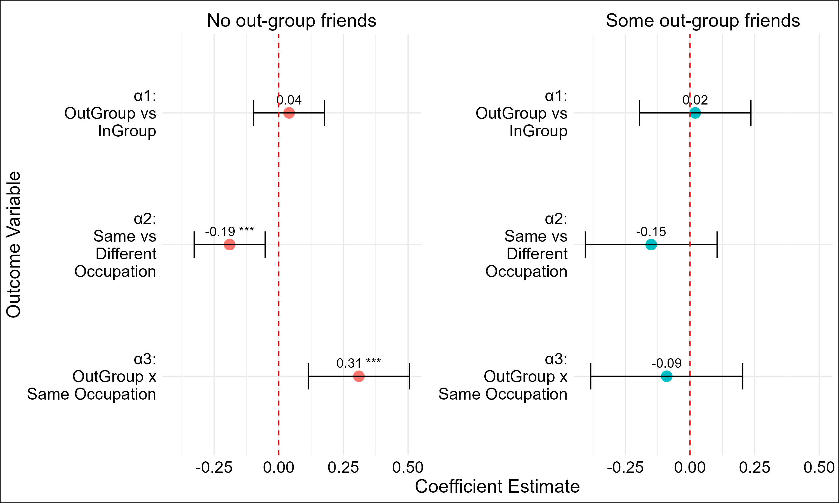
Does host list a single refugee friend?

Slide 33
CONCLUDING REMARKS

Slide 34
Is perceived, not actual, job competition driving the results?
Significantly more negative attitudes when host exposed to refugee vignette character in same occupation
But result is driven by Addis Ababa, where refugees are a tiny share of labor force.
Importantly, attitudes towards refugee in same job strongest in occupation locations with lowest refugee concentrations
Lebow et al (2024) – Anti-migrant sentiment strongest in areas that do not receive many migrants

Slide 35
Quality of refugee-host interactions appears to influence host attitudes
Hosts who speak the same language as dominant refugee group and have at least one refugee friend – attitudes towards refugee in same occupation are unaffected
Selection bias with contact hypothesis
Betts et al (2023) – strong social cohesion among ethnic Somalis and Somali refugees

Slide 36
THANK YOU csalemi@uvic.ca

Slide 37
DO RESPONSES REFLECT TRUE BEHAVIOR?
Hypothetical bias
Social desirability bias
Strategic behavior
Validity of vignette experiment?
Past work suggests that when costs associated with actions are higher, vignette experiments overstate willingness to take action (Hainmueller et al. 2015, Whiting and Ma 2021)

